Slide 1
LECTURE 8 Configure and Manage Group Policy

Slide 2
Configure and Manage Group Policy
Configure Group Policy in Windows
Managing Group Policy in Windows
Linux Users and Groups

Slide 3
Group Policy is a tool that is available to administrators that are running a Windows 2000 or later Active Directory Domain.
It allows for centralized management of settings on client computers and servers joined to the domain as well as providing a rudimentary way to distribute software.
Group Policy provides centralized management and configuration of operating systems, applications, and users' settings in an Active Directory environment.
A set of Group Policy configurations is called a Group Policy Object (GPO).

Slide 4
Active Directory Domain Services (ADDS) is a server role within Microsoft Windows that is used to store and structure objects.
Objects managed within ADDS can be computers, users or groups.
To add additional configuration and management to object types within ADDS, group policy is used.
Group Policy is a feature within Windows used to control configuration and behavior settings.
A collection or group of settings are called group policy objects.
Ref: https://study.com/academy/lesson/group-policy-objects-in-windows-server-2012-r2-overview-types.html#:~:text
=There%20are%20three%20types%20of%20GPOs%20%2D%20local%2C%20nonlocal%20and%20starter,create%20new
%20GPOs%20within%20ADDS.

Slide 5
Introduction to Group Policy
https://www.youtube.com/watch?v=cKbgHaQG6BI&list=PL1l78n6W8zyor7Fd46FQpFL8qo4cb0xMT
Windows Server 2019 Group Policy Explained - Bing video
Installing group policy
https://www.youtube.com/watch?v=7LxGCExHDgU&list=PL1l78n6W8zyor7Fd46FQpFL8qo4cb0xMT&index=2
https://www.hammer-software.com/how-to-install-the-group-policy-management-console-tools-gpmc-on-a-windows-serv

Slide 6
Windows group policy types
The three Group Policy types are Local, Non-local, and Starter.
Local GPOs (GPO stands for Group Policy Object) apply to the local computer only on Windows client.
Often referred to as LGPO which stands for Local Group Policy Object.
Non-local- apply settings to one or multiple Windows clients by linking them to sites, domains or organizational units (OUs) within ADDS.
Starter - are templates used to create new GPOs within ADDS.
Group Policy Types and components
https://youtu.be/0sei0cE2aUw
* Active Directory Domain Services (ADDS)

Slide 7
Benefits of Group Policy Objects
Ease of administration -- system administrators can deploy software, patches and other updates via GPO.
Better password policy enforcement -- GPOs determine password length, reuse rules and establish other requirements for passwords to keep a company's network safe.

Slide 8
Group Policy Processing Order
https://www.youtube.com/watch?v=UmEyq49rYyk
Group Policy Preferences
https://www.youtube.com/watch?v=vPCiFU_0l5E

Slide 9
Components of Group Policy Settings Preferences
https://www.youtube.com/watch?v=M_JORkMO62U&list=PL1l78n6W8zyor7Fd46FQpFL8qo4cb0xMT&index=4
Creating and linking GPOs
https://www.youtube.com/watch?v=Igru_UrBVZI&list=PL1l78n6W8zyor7Fd46FQpFL8qo4cb0xMT&index=5
Filtering Group Policy
https://www.youtube.com/watch?v=hkBWKEw9I6I&list=PL1l78n6W8zyor7Fd46FQpFL8qo4cb0xMT&index=8

Slide 10
Configure a Central Store
https://www.youtube.com/watch?v=0-0luRhTES4&list=PL1l78n6W8zyor7Fd46FQpFL8qo4cb0xMT&index=9

Slide 11
Linux Users and Groups
Linux was designed to allow more than one user to have access to the system at the same time.
In order for this multiuser design to work properly, there needs to be a method to protect users from each other.
This is where permissions come in to play.
Ref: https://www.linode.com/docs/guides/linux-users-and-groups/

Slide 12
User groups play an important role on Linux systems.
They provide an easy way for a selected groups of users to share files with each other.
They also allow sysadmins to more effectively manage user privileges, since they can assign privileges to groups rather than individual users.
Ref: https://www.networkworld.com/article/3409781/mastering-user-groups-on-linux.html

Slide 13
Read, Write & Execute Permissions
Permissions are the “rights” to act on a file or directory.
The basic rights are read, write, and execute.
Read - a readable permission allows the contents of the file to be viewed.
A read permission on a directory allows you to list the contents of a directory.
Write - a write permission on a file allows you to modify the contents of that file. For a directory, the write permission allows you to edit the contents of a directory (e.g. add/delete files).
Execute - for a file, the executable permission allows you to run the file and execute a program or script. For a directory, the execute permission allows you to change to a different directory and make it your current working directory.
Users usually have a default group, but they may belong to several additional groups.

Slide 14
Viewing File Permissions
To view the permissions on a file or directory, issue the command ls -l <directory/file>.
Remember to replace the information in the <> with the actual file or directory name.
Below is sample output for the ls command:
-rw-r--r-- 1 root root 1031 Nov 18 09:22 /etc/passwd
The first ten characters show the access permissions.

Slide 15
Viewing File Permissions
The first dash (-) indicates the type of file (d for directory, s for special file, and - for a regular file).
The next three characters (rw-) define the owner’s permission to the file.
In this example, the file owner has read and write permissions only.
The next three characters (r–) are the permissions for the members of the same group as the file owner (which in this example is read only).
The last three characters (r–) show the permissions for all other users and in this example, it is read only.

Slide 16
Creating and Deleting User Accounts
To create a new standard user, use the useradd command.
The syntax is as follows:
useradd <name>

Slide 17
Add user
Most user accounts on Linux systems are set up with the user and group names the same.
The user "jdoe" will be set up with a group named "jdoe" and will be the only member of that newly created group.
The user’s login name, user id, and group id will be added to the /etc/passwd and/etc/group files when the account is added.
Ref: https://www.networkworld.com/article/3409781/mastering-user-groups-on-linux.html

Slide 18
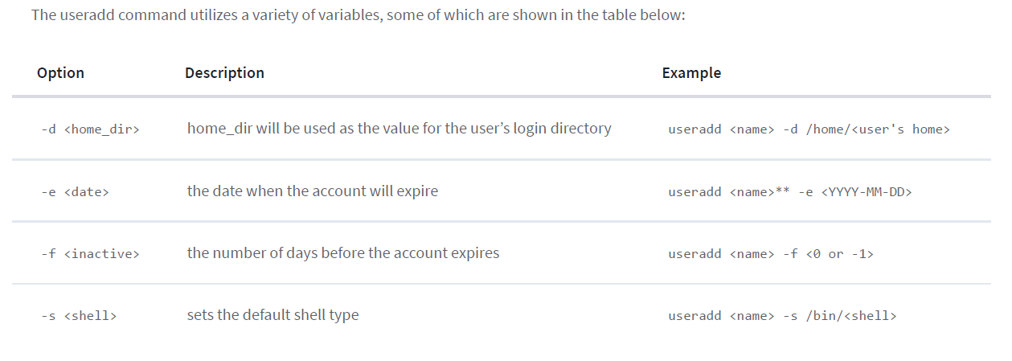

Slide 19
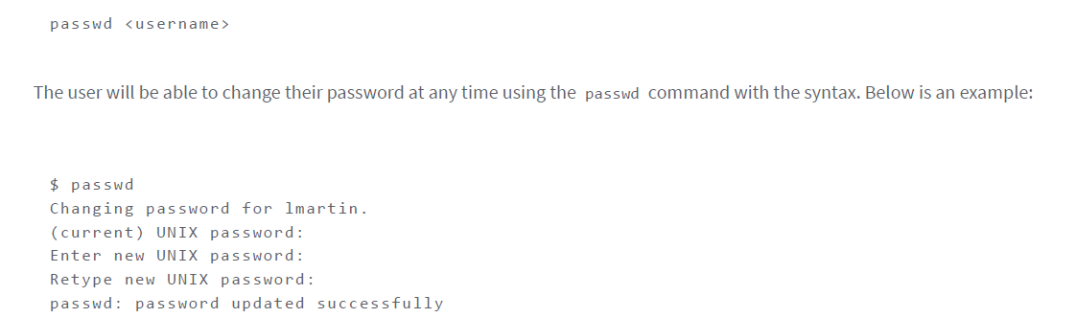

Slide 20
To remove the user
To remove the user, their home folder, and their files, use this command:
userdel -r <name>

Slide 21
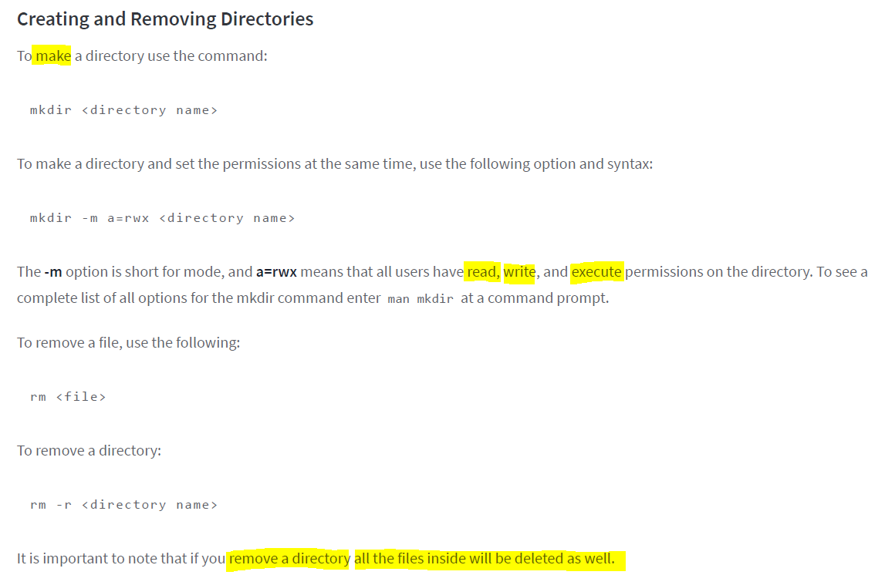

Slide 22
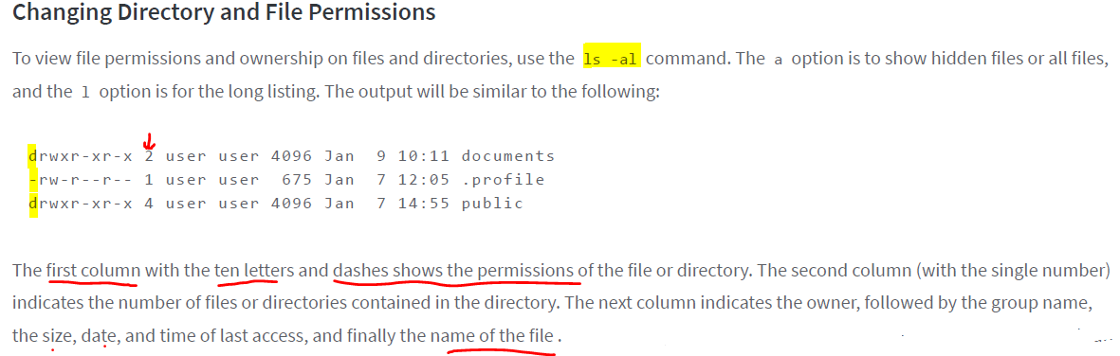

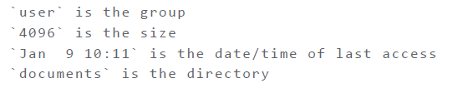
Explanation of each lines

Slide 23
chmod Command
The command chmod is short for change mode.
chmod is used to change permissions on files and directories.
The command chmod maybe used with either letters or numbers (also known as octal) to set the permissions.
Ref: https://www.linode.com/docs/guides/linux-users-and-groups

Slide 24
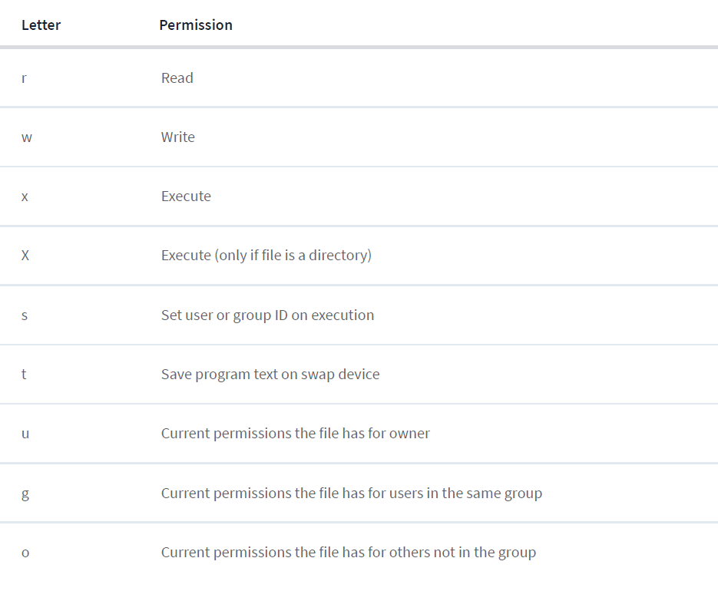

Slide 25
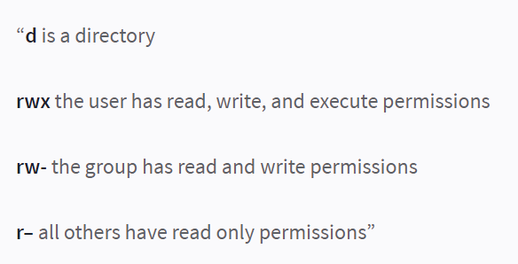
It is important to remember that the first character of the first column of a file listing denotes whether it is a directory or a file.
The other nine characters are the permissions for the file/directory.
The first three characters are for the user, the next three are for the group, and the last three are for others.
The example drwxrw-r– is broken down as follows:

Slide 26
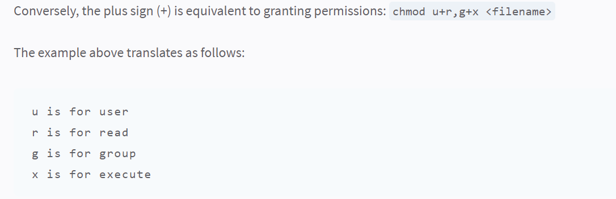
chmod Command

Slide 27
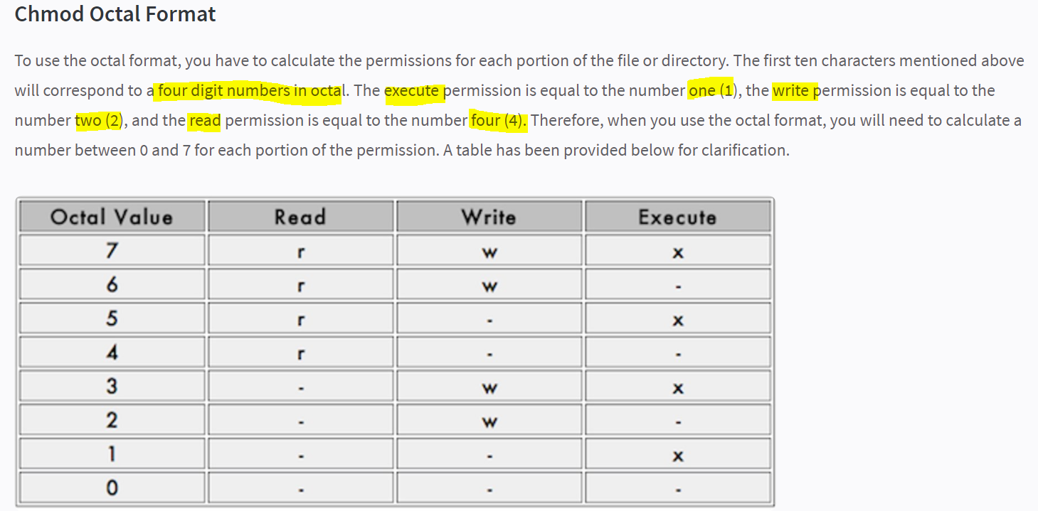

Slide 28
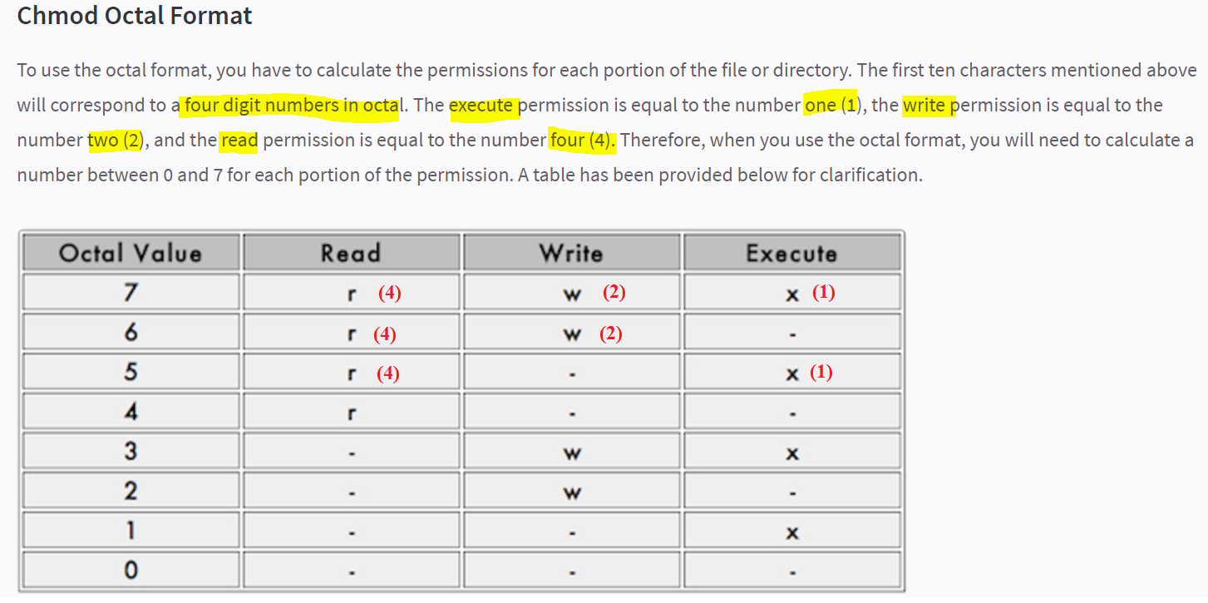

Slide 29
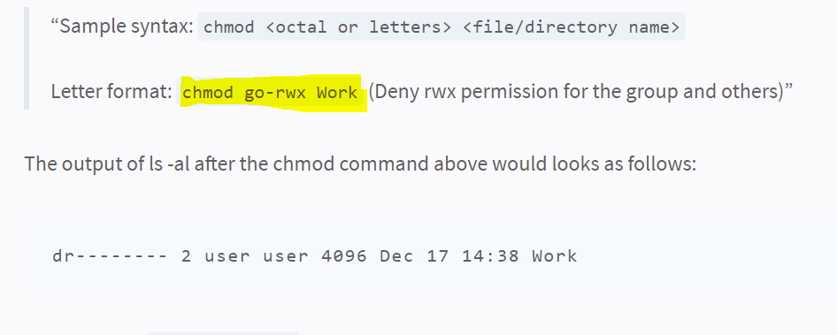
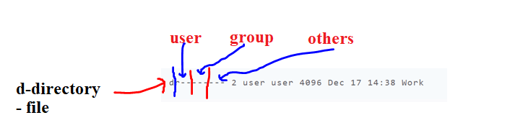

Slide 30
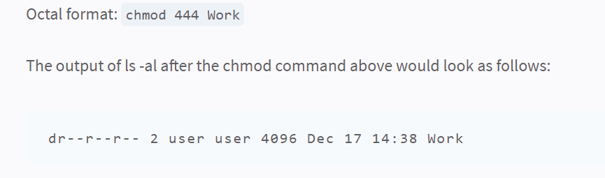

Slide 31
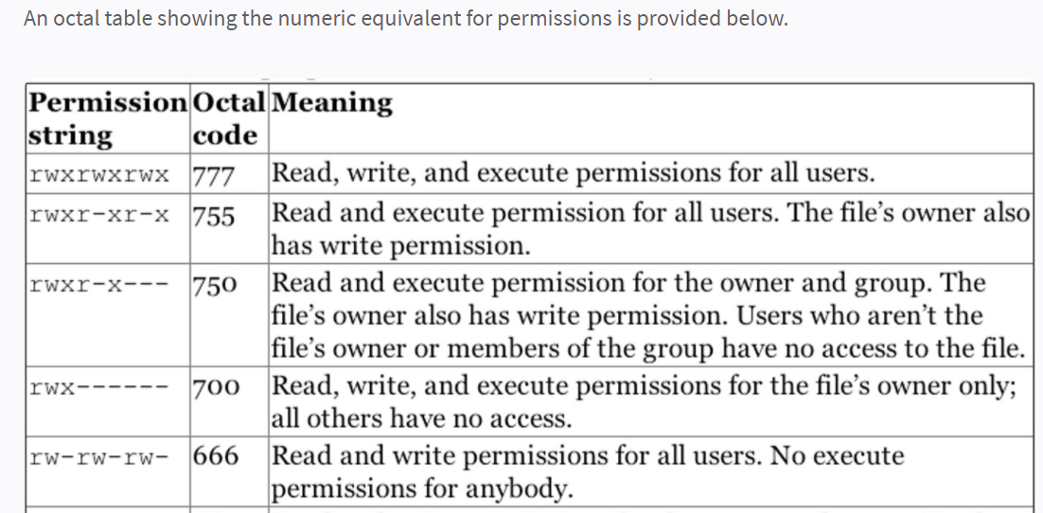

Slide 32
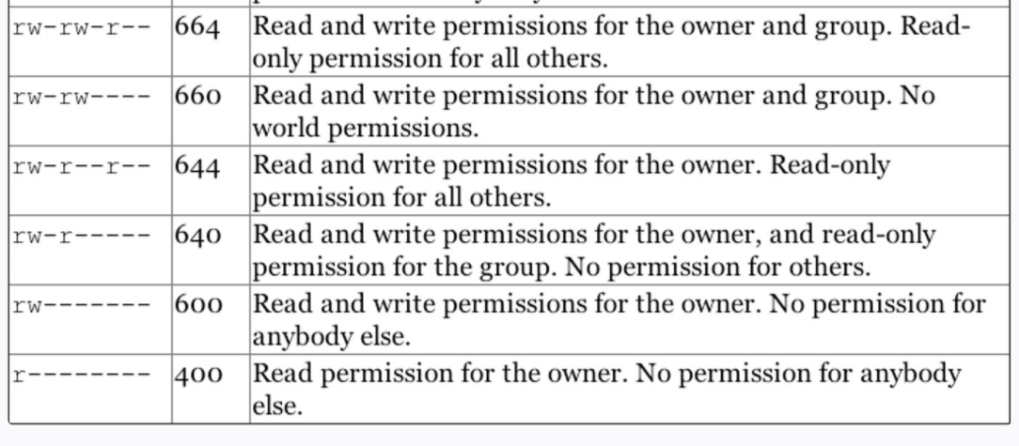

Slide 33
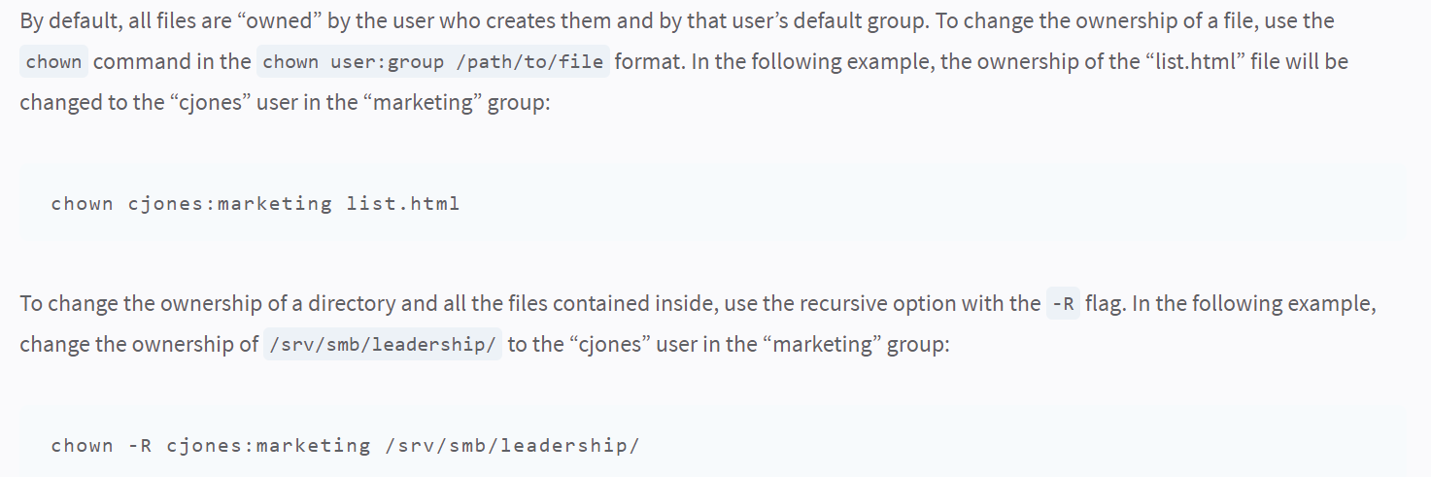

Slide 34
Leveraging Users and Groups
In many cases, user permissions are used to provide your system with greater security without any direct interaction. Many operating systems create specific system user accounts for different packages during the installation process.
The best practice is to give each user their own login to your system. This protects each user’s files from all other users.
Furthermore, using specific accounts for users allows more accurate system logging, particularly when combined with tools like sudo. We recommend avoiding situations where more than one individual knows the password for a user account for maximum security.
In contrast, groups are useful for allowing multiple independent user accounts to collaborate and share files.
If you create groups on a machine for common tasks on a per-task basis (e.g. web editors, contributors, content submitters, support) and add relevant users to the relevant groups, these users can all edit and run the same set of files without sharing these files with the world.
Use of the chown command with file permissions of 770 and 740 would help accomplish this goal.

Slide 35
Ref: https://www.linode.com/docs/guides/linux-users-and-groups

Slide 36
Ref: https://www.linode.com/docs/guides/linux-users-and-groups

Slide 37
Ref: https://www.linode.com/docs/guides/linux-users-and-groups

Slide 38
Ref: https://www.linode.com/docs/guides/linux-users-and-groups
Error:How to fix the specified server cannot perform the requested operation. – YouTube
The specified server cannot perform the requested operation | ManageEngine Endpoint Central
Error: FIX: The Sign-in method you're trying to use isn't allowed
The error "The Sign-in method you're trying to use isn't allowed. For more info, contact your network administrator", commonly appears when you try to log on using the "Guest" account to a Windows 10 PC, or to a Domain Controller with any other user than then Domain Administrator. The error appears, because by default you cannot sign in locally with any user that hasn't administrator permissions on a Domain Controller or to a Windows 10 PC . SOULUTION: Fix “The sign in method you’re trying to use isn’t allowed” - YouTube

Slide 39

The End

